Slide 1
Techniques of performance boost in relationship database
Authors: Andreea Toma
Adrian Paunescu
Mihaela Dobre
Dinca Marius Catalin

Slide 2
Goal and motivation
Without using a high tech database software solution(Oracle Exadata for example), with the amount of data of today is quite hard to obtain an acceptable result from performance point of view for our “hardest” query execution.
The main goal here is to get the best result from time and resources point of view, for specific database queries execution, taking in consideration the limitation we may encounter.
To achieve this, we are going to simulate real life situations and different scenarios on:
Oracle database 12.2;

Slide 3
Database configuration used for simulate scenarios
Oracle database 12.2 configuration used:
CPU | cpu_count | 8
MEMORY | sga_target | 2432M
 | pga_aggregate_target | 807M
Parameters that influence JOINs | hash_area_size | 128Kb
 | bitmap_merge_area_size | 1M
 | sort_area_size | 64Kb
In analyzing the results, we are going to use two measurements:
- time of running;
- PGA consummation;

Slide 4
Project overview
external source1
…
data loading
using PLSQL
procedures
sabdadm
(oracle schema)
sabduser
(oracle schema)
external source n
application
developed this part

Slide 5
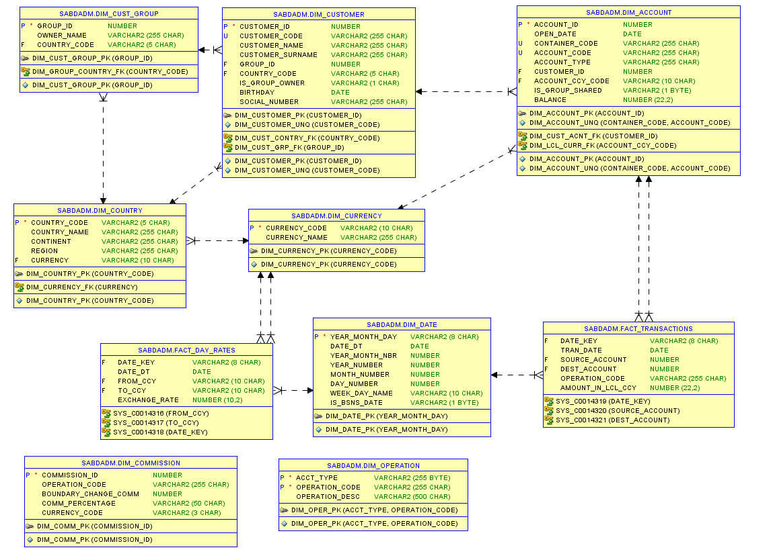
ERD of Oracle backend schema (SABDADM)

Slide 6
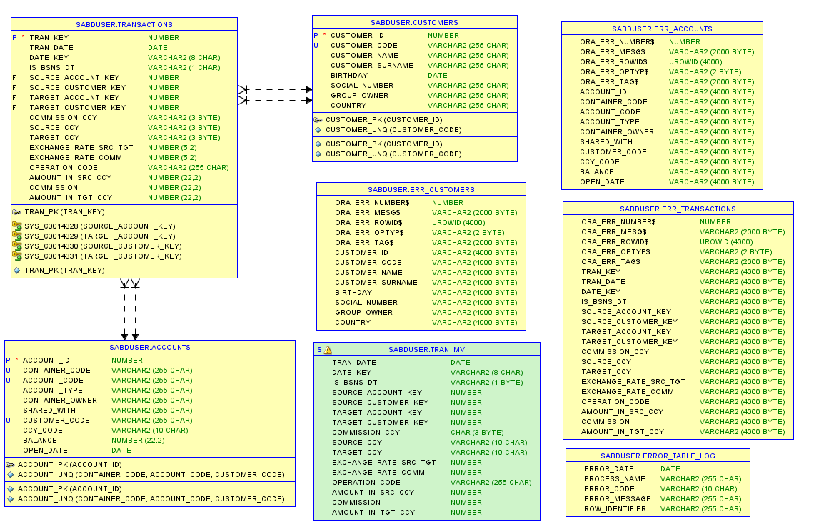
ERD of Oracle frontend schema (SABDUSER)

Slide 7
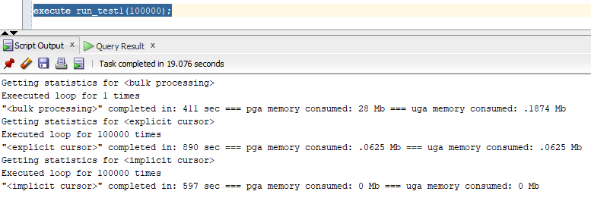
T1: Performance analysis with bulk processing, implicit and explicit cursors
In our project we had to generate random data. We wanted different data on
each row, so we needed a row by row processing. Since this cannot be done only in SQL,
explored some PL/SQL options: collections with bulk processing, implicit cursor and
explicit cursor.

Slide 8
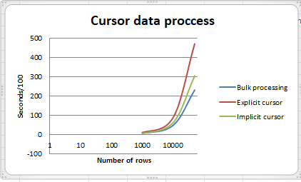
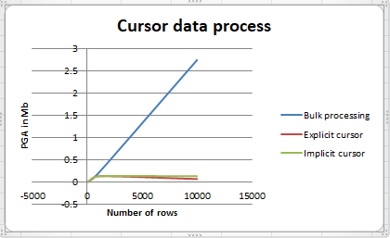
T1: Performance analysis with bulk processing, implicit and explicit cursors
The results can be seen bellow:
Bulk processing it is not a viable solution, does not provide random data on each row as we
want. Instead of switching to PL/SQL for bulk, we’ve could have done that directly in SQL by
using “connect by level” statements.

Slide 9
T1: Performance analysis with bulk processing, implicit and explicit cursors
Conclusions:
Bulk processing is faster because is doing a single context switching and process all rows at once;
Bulk processing is “eating” our PGA because all rows are kept in memory, to the difference of explicit and implicit cursors;
Explicit and implicit cursors are running slower because for each processed row, are doing a context switching;
Implicit cursor is running faster than explicit cursor because operations of “open”, “fetch” and “close” are not performed and process the row as soon as is retrieved from the database;
In the end we chose to use implicit cursors for generating the data, but before that, explored some other options: function tables.

Slide 10
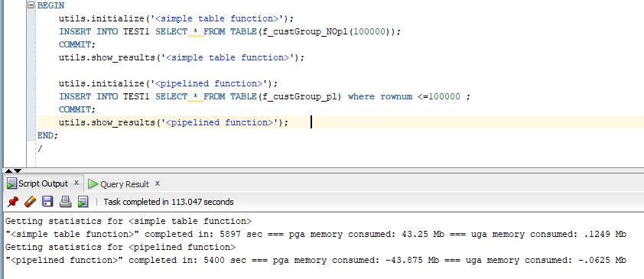
T2: Pipelined function versus non pipelined functions

Slide 11
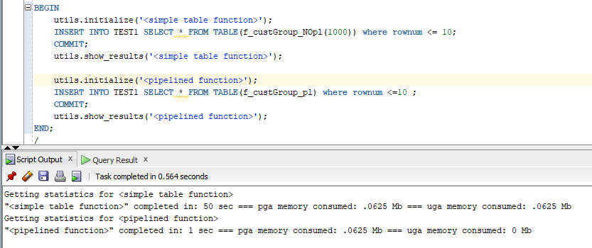
T2: Pipelined function versus non pipelined functions
None of these options were viable for what we needed, generating data via functions is taking 10x longer for row by row processing.
The main difference between the two of them, is that as soon as a row is retrieved, the pipelined functions are pipe-ing them to stdout. Following test is more concluding:
Pipelined function finish faster, because it will process only 10 rows. Non pipelined function will process 1000 rows in this case, load them in memory and afterwards, will limit the output to 10 rows.

Slide 12
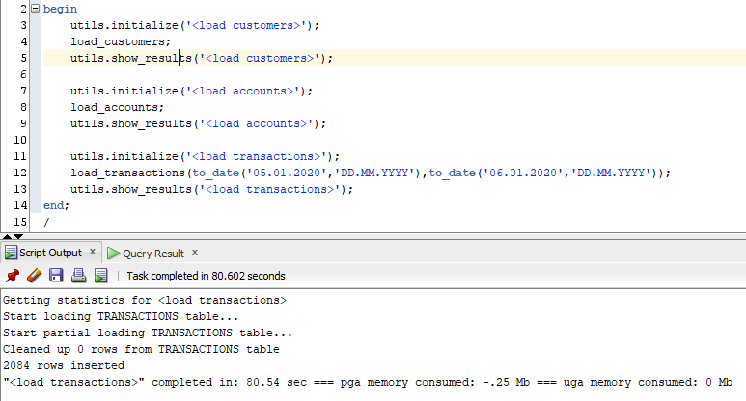
T3– performance boost using horizontal table partitioning
After that, we started populate SABDUSER schema from SABDADM. We had performance issues when we were populating “transactions” table:

Slide 13
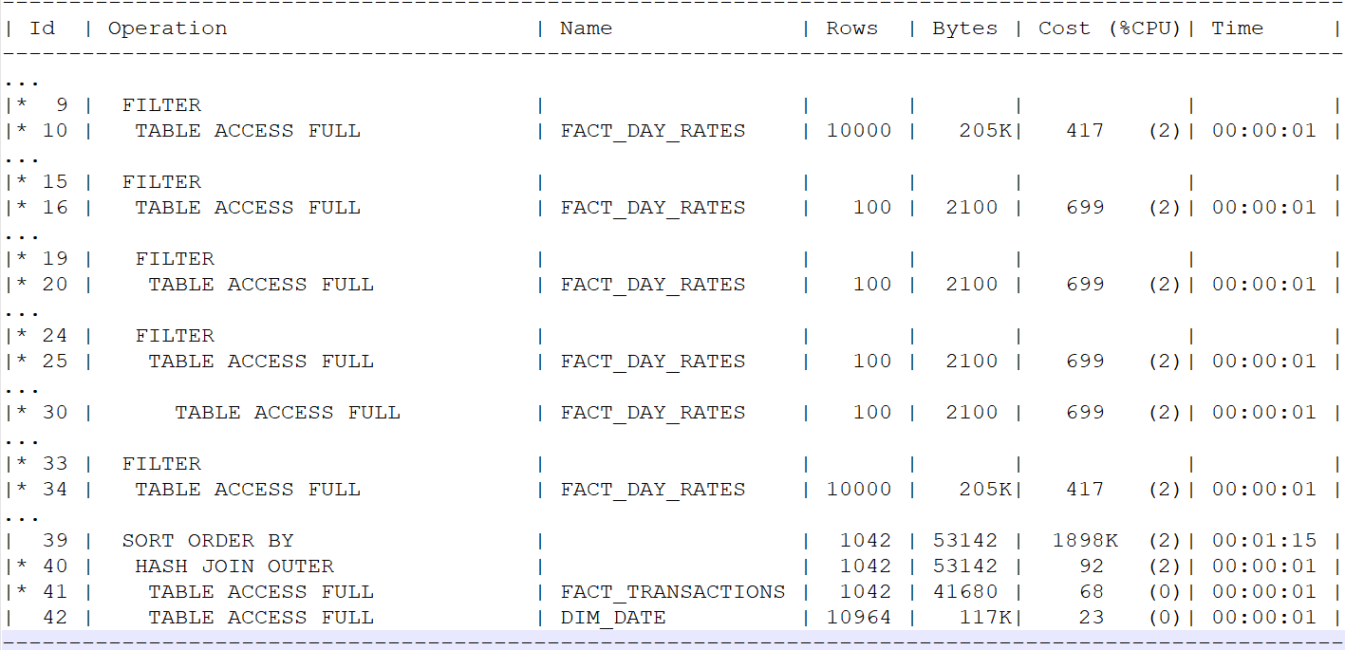
T3– performance boost using horizontal table partitioning
Checking the explain plan here, noticed that there were a lot of full table scans:

Slide 14
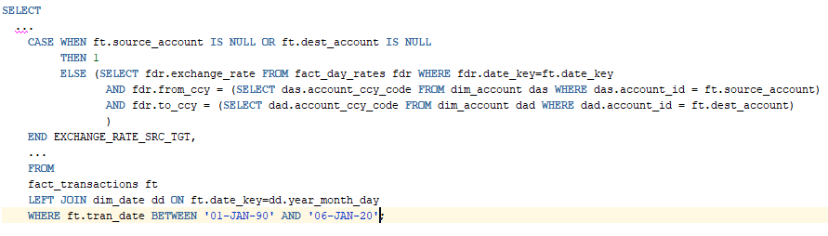
T3– performance boost using horizontal table partitioning
We had to improve the query that loads our table:
We took the decision to partition the two tables as:
FACT_DAY_RATES by list, because in the filters we are using “from_ccy=…” and “to_ccy=…”. We partitioned by “from_ccy”, but we could have used also “to_ccy”; FACT_TRANSACTIONS by range, because of the “where” condition. We partitioned by column “tran_date”;

Slide 15
T3– performance boost using horizontal table partitioning
There are two types of partitioning:
Partitioning by list;
Partitioning by range;
Using partitioning, we avoid a full index scan, or worse, a full table scan and we only looking into specific partition(s). In Oracle database, in order to look into a specific partition, we can either select from that partition or use in the “WHERE” the column that is used for partitioning:
SELECT ….
FROM <table> PARTITION (“<partition_name>”);
SELECT …
FROM <table>
WHERE <column_used_for_partition> <condition> …

Slide 16
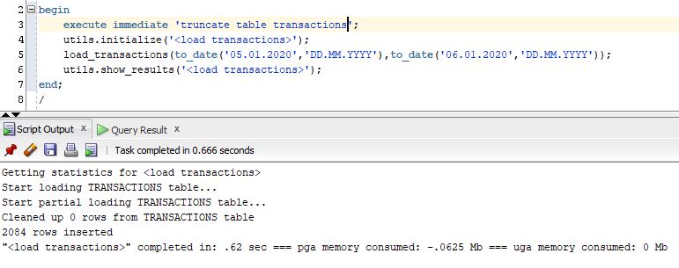
T3– performance boost using horizontal table partitioning
After the two tables were partitioned, loading data process improved considerably from ~80 seconds for 2084 rows to less than a second:

Slide 17
T4– performance boost using materialized views
We also analyzed the benefits of using materialized views. Materialized views are a database object, now available in the most of database systems. They were first implemented by Oracle, followed by the others RDBMS as well.
The main difference between materialized views and normal views, is that in the materialized views case the result of the query that forms it is cached. It will not be changed, until the view is refreshed. They basically represent a snapshot of the data present at moment x in the database.
In SQL Server, materialized views are implemented in a different way and they are known more under the “Indexed views” term. The difference in this case is that the views are always synchronized with the data from the based tables that creates the view.

Slide 18
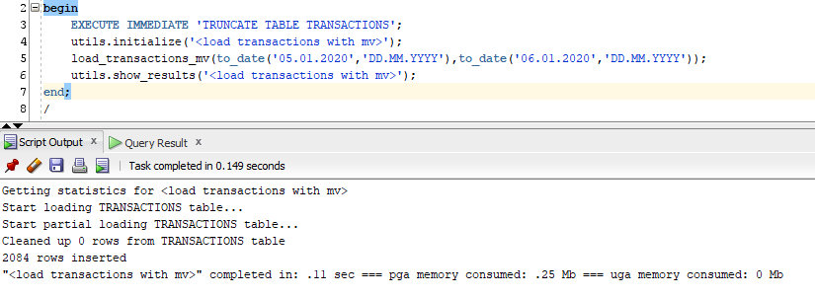
T4– performance boost using materialized views
After creating a materialized view from the select statement that populate our table and a procedure that loads the data from created materialized view, the results were even better:
After partitioning and materialized view changes, we managed to do a full transaction load (~35k rows) in 1.4 seconds, instead of ~1900 seconds as it was initially.

Slide 19
Additional implementations
Logging errors
We had to come with a way of not intreruping a loading when a row cannot be merged or inserted and also know the reason for it. We avoided using additional PL/SQL blocks with PRAGMA_AUTONOMOUS_TRANSACTION and we chose to use a 11.2 Oracle package called DBMS_ERRLOG. We created an error table for each table using:
DBMS_ERRLOG.CREATE_ERROR_LOG(<table_name>, <error_table_name>)
which is having columns with information about encountered errors. Also we added at the end of each merge and insert statement line:
LOG ERRORS INTO <error_table_name> (<tag>) REJECT LIMIT UNLIMITED;
making each rejected row to populate the error table accordingly.
We also added a table that contains the merged errors called ERROR_TABLE_LOG. We populate this table dynamically, by calling a procedure in the others, if there are rows rejected.

Slide 20
Additional implementations
Automatic deploy
Everything is created automatically, by running a bat file (deployDb.bat). First step of deploy is to create a separate tablespace and afterwards the users and because of this, there is a dependency of a privileged user: password for sys user must exist in orapwd file.
Automatic data generation
This is done with SQL*Loader and with two packages created under SABDADM schema. Everything is done in one step, by running a bat file (loadData.bat).
Automatic test executions
All tests presented can be re-executed again after deploy and data load, by running bat files (test1.bat, test2.bat, test3.bat, test4.bat).

Slide 21
Conclusions
Keep it simple. Don’t do rocket science unless needed;
If you can do it in SQL, do it in SQL.
There is no “the right way to do it”, but there is “the right way to do it in a specific situation”.

Slide 22
Articles
Data processing
Bulk processing
Explicit vs Implicit Cursors
Table functions
Oracle pipelined table functions
Table functions
Partitioning
Horizontal partitioning
Vertical partitioning in raw data
Materialized views
Oracle materialized views
Query rewrite

